Slide 1
CONTENTS
1.ABSTRACT
2.INTRODUCTION
3.SCHEMA DIAGRAM
4.ER-DIAGRAM
5.OBJECTIVE
6.PROBLEM STATEMENT
7.REQUIREMENT SPECIFICATION
8.SNAP SHOTS
9.PROPOSED SYSTEM
10.REFERENCES/BIBILOGRAPHY

Slide 2
ABSTACT
Life insurance management system is basically a system which provides and maintains the policy for people.
In this system we included a features in which customer can apply the policy .
Policies includes information's like ‘tenure’,’premium’ .
Admin can add the policies and category of policy .
When customer applied the policy then Admin can approve or reject the policy of the requested customer.

Slide 3
INTRODUCTION
Life Insurance Management System is a web-based application that mainly focuses on providing the operation to apply the policy.
customer can view, apply or delete their policies by logging into their respective account using username and password.
Customer can have interaction with Insurance compony by asking any questions in question section.
Admin is the superuser where he can view details about customer and add the policies with the information's regarding policy value and time.
Stored procedures are used to calculate the premium of the policy for one year.

Slide 4
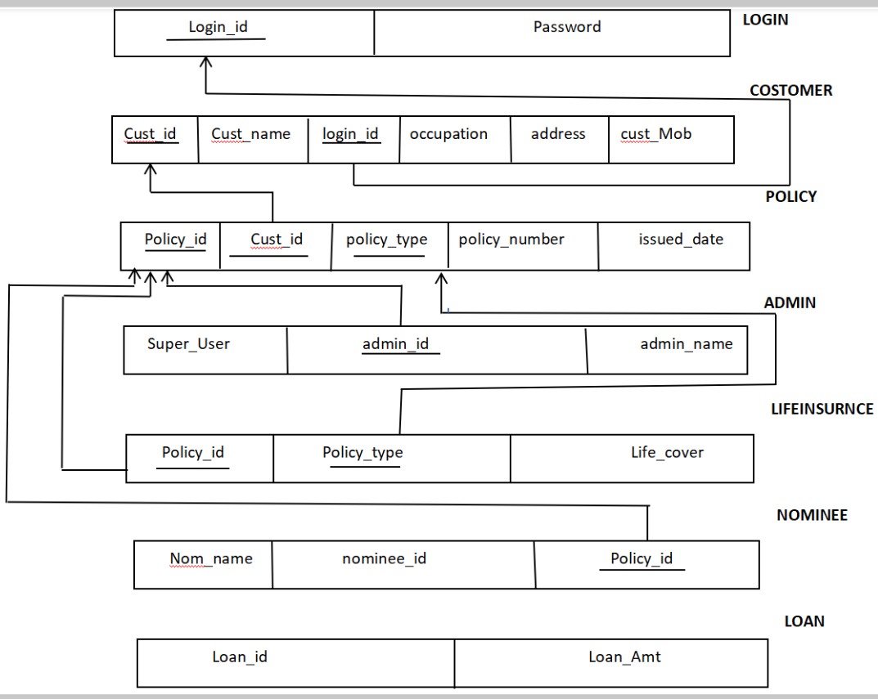
SCHEMA DIAGRAM

Slide 5
OBJECTIVE
The main objective of this project is to apply policy from the customer in a simple way.
The customer and admin can login through their login id and password but first time customer need to be registered.
This can be achieved with web development technologies like HTML,CSS,Django,MySQL etc.

Slide 6
REQURIMENT SPECIFICATION
1.HARDWARE REQUIREMENTS:
Hard disk
RAM
Monitor
Keyboard
Processor PIV
2.SOFTWARE REQUIREMENTS:
Visual studio code 6.0
Django 3.0.5
Python 3.8.8
MS access

Slide 7

SNAP SHOTS
Home

Slide 8
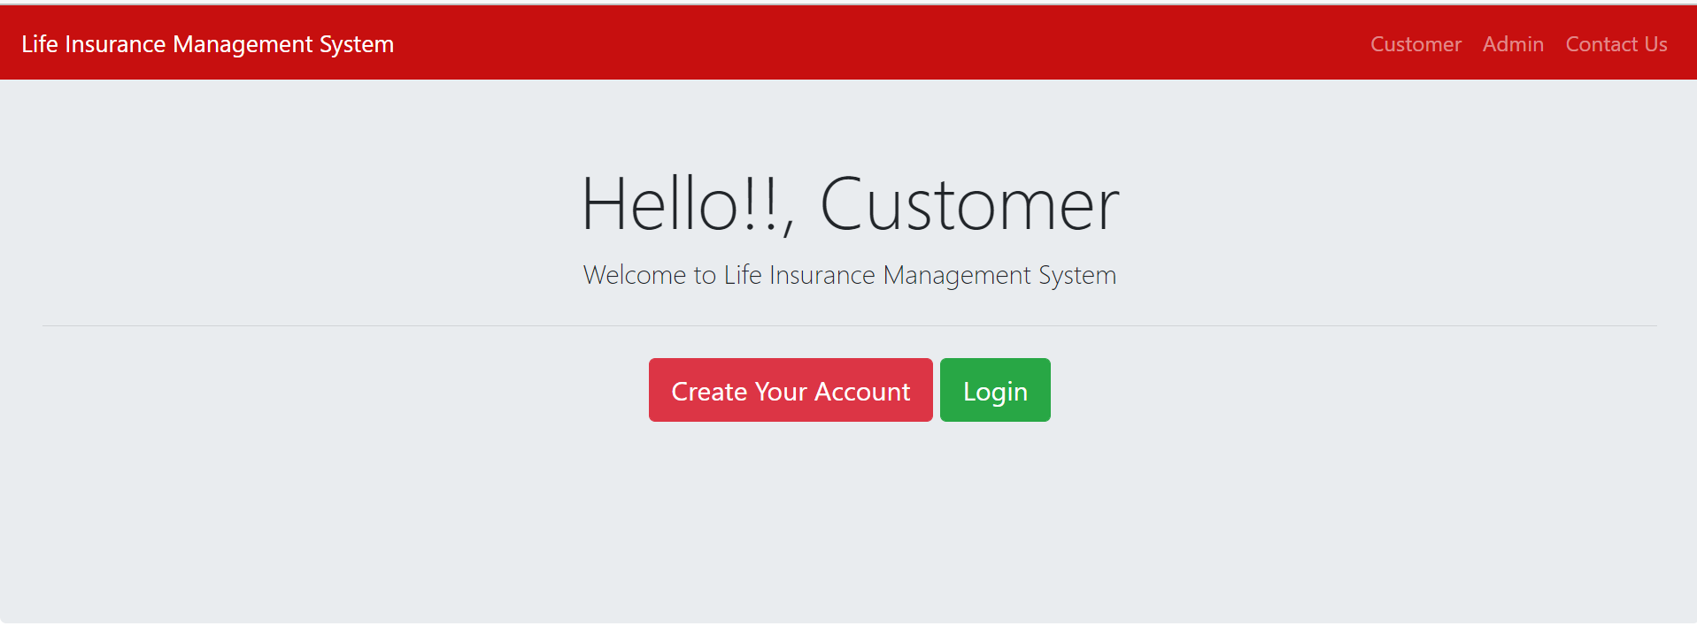
CUSTOMER/ADMIN LOGIN FORM

Slide 9
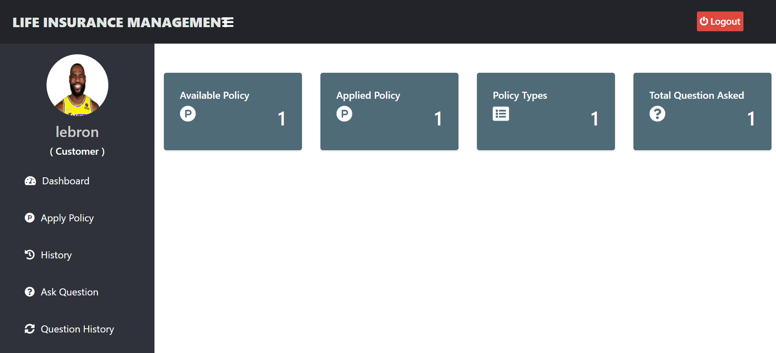
CUSTOMER DASHBOARD

Slide 10
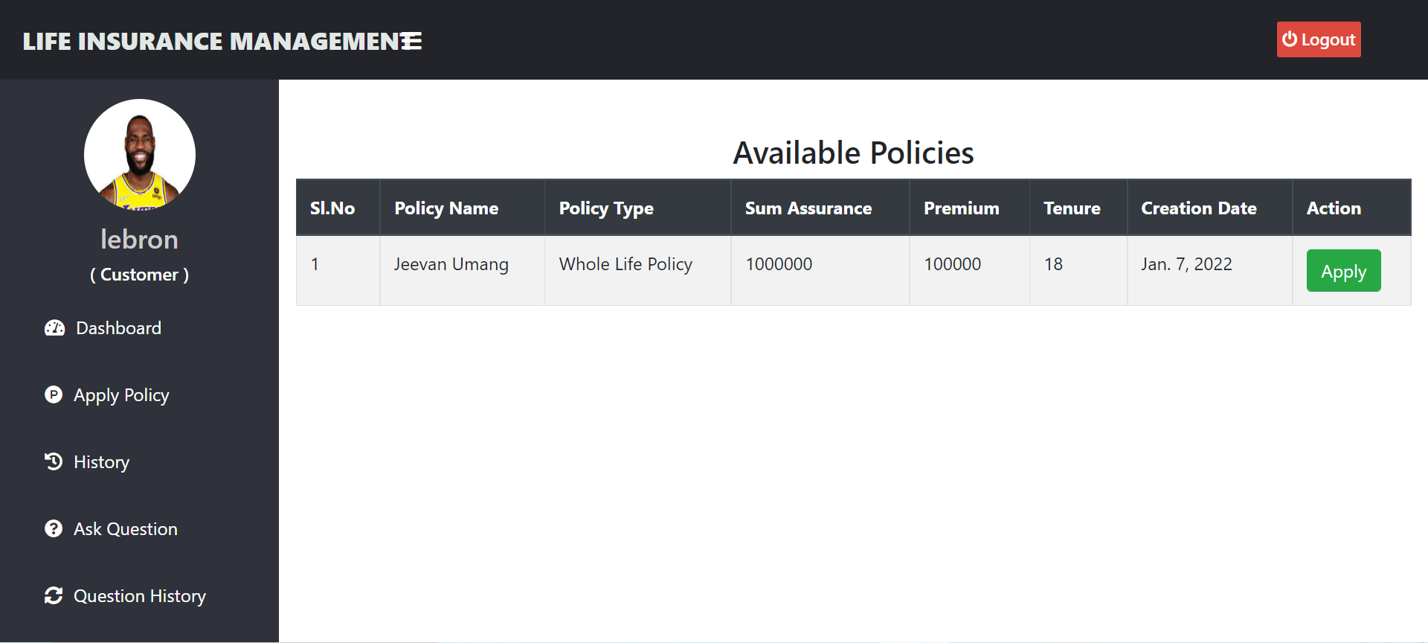
Applying for policy

Slide 11
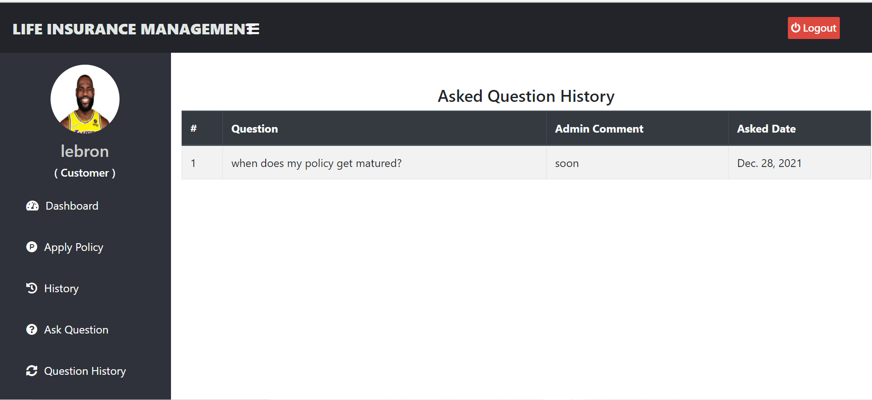
QUESTION HISTORY

Slide 12
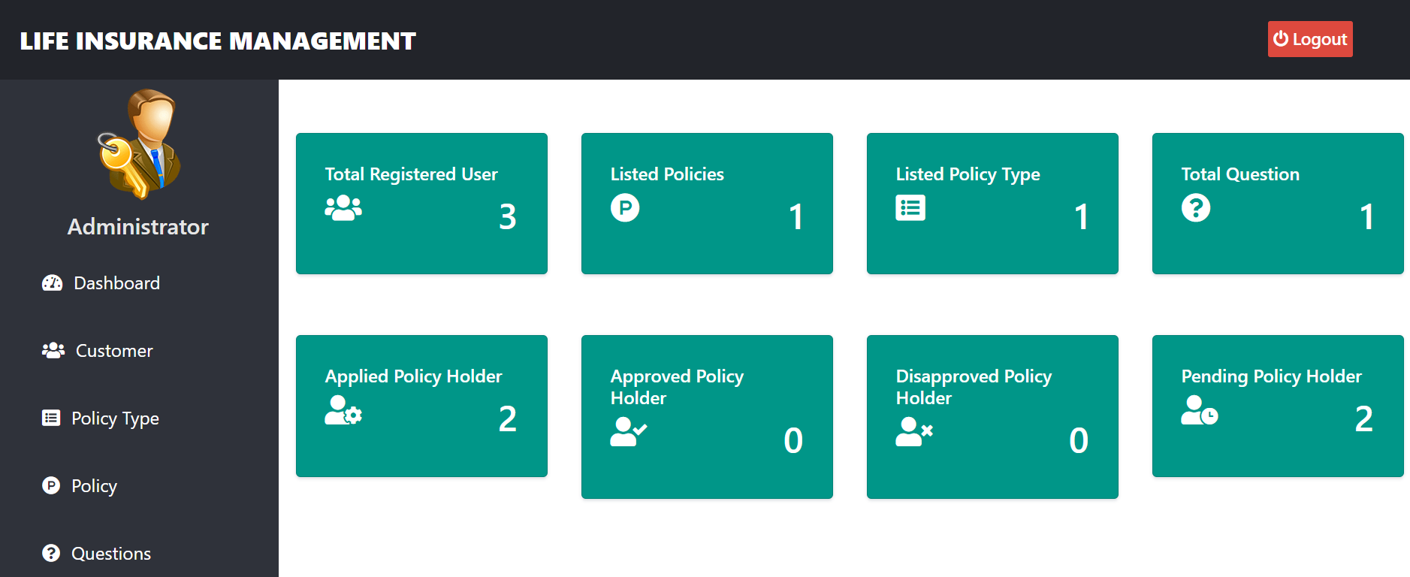
ADMIN DASHBOARD

Slide 13
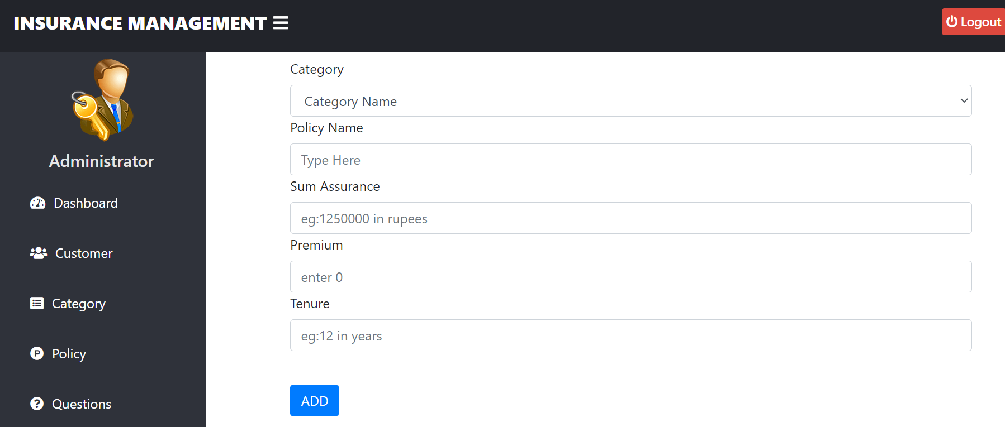
POLICY CREATION

Slide 14
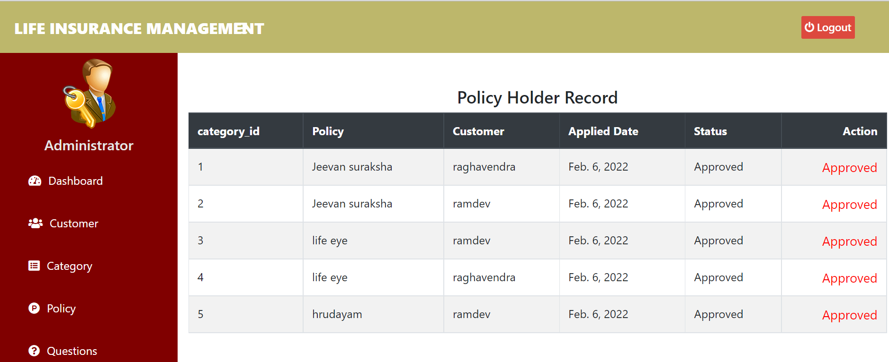
POLICYRECORD HOLDER

Slide 15
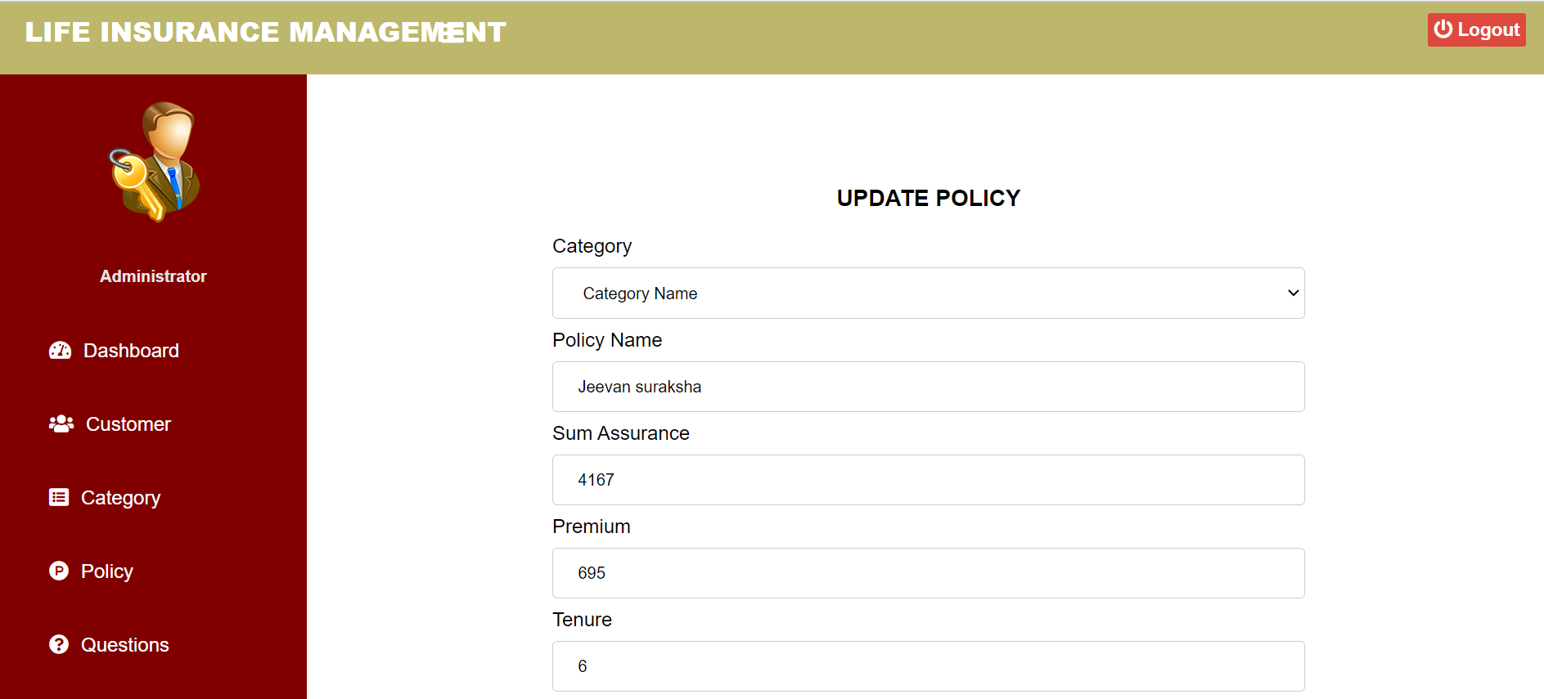
UPDATING POLICY

Slide 16
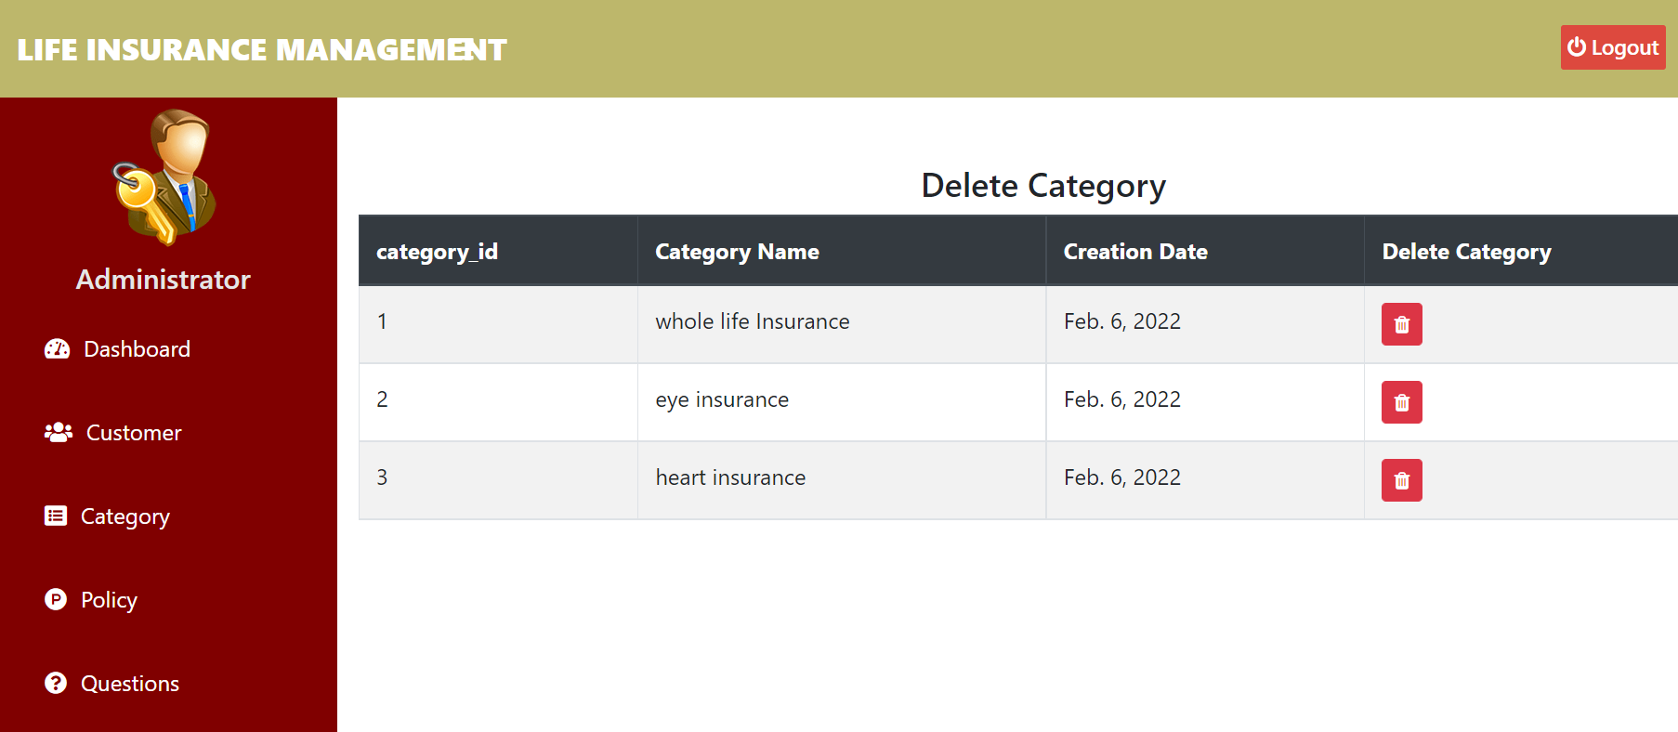
DLETE CATEGORIES

Slide 17
PROPOSED SYSTEM
The main aim of this project is to implement an efficient database system.
It is capable of storing and retrieving huge data files in a secured manner by making use of the sql commands.

Slide 18
REFERENCES
http://www.wikipedia.org
http://www.getsetproject.com
http://www.google.com
http://www.github.com
http://www.w3schools.com
http://www.tutorialpoint.com
http://localhost/customer/
http://www.python.org

Slide 19

thank YOU

